Slide 1
Welcome to Marketing Operations Open Office Hours – October Session

Slide 2
Agenda
Welcome
Intro to Paid Campaign resources - Shivasagar Biradar
Demo on how to pull website metrics using Marketing Performance Hub (MPH) - Sandeep Kamboj
Q&A

Slide 3
Intro to Paid Campaign resources
Shivasagar Biradar
Marketing Operations Open Office Hours October 8, 2025

Slide 4
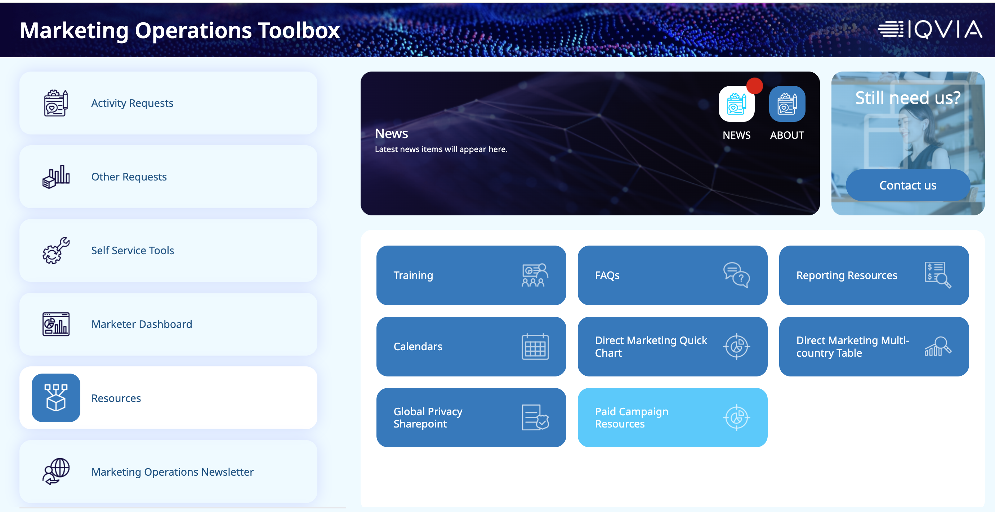
Resources section under Marketing Operations toolbox

Slide 5
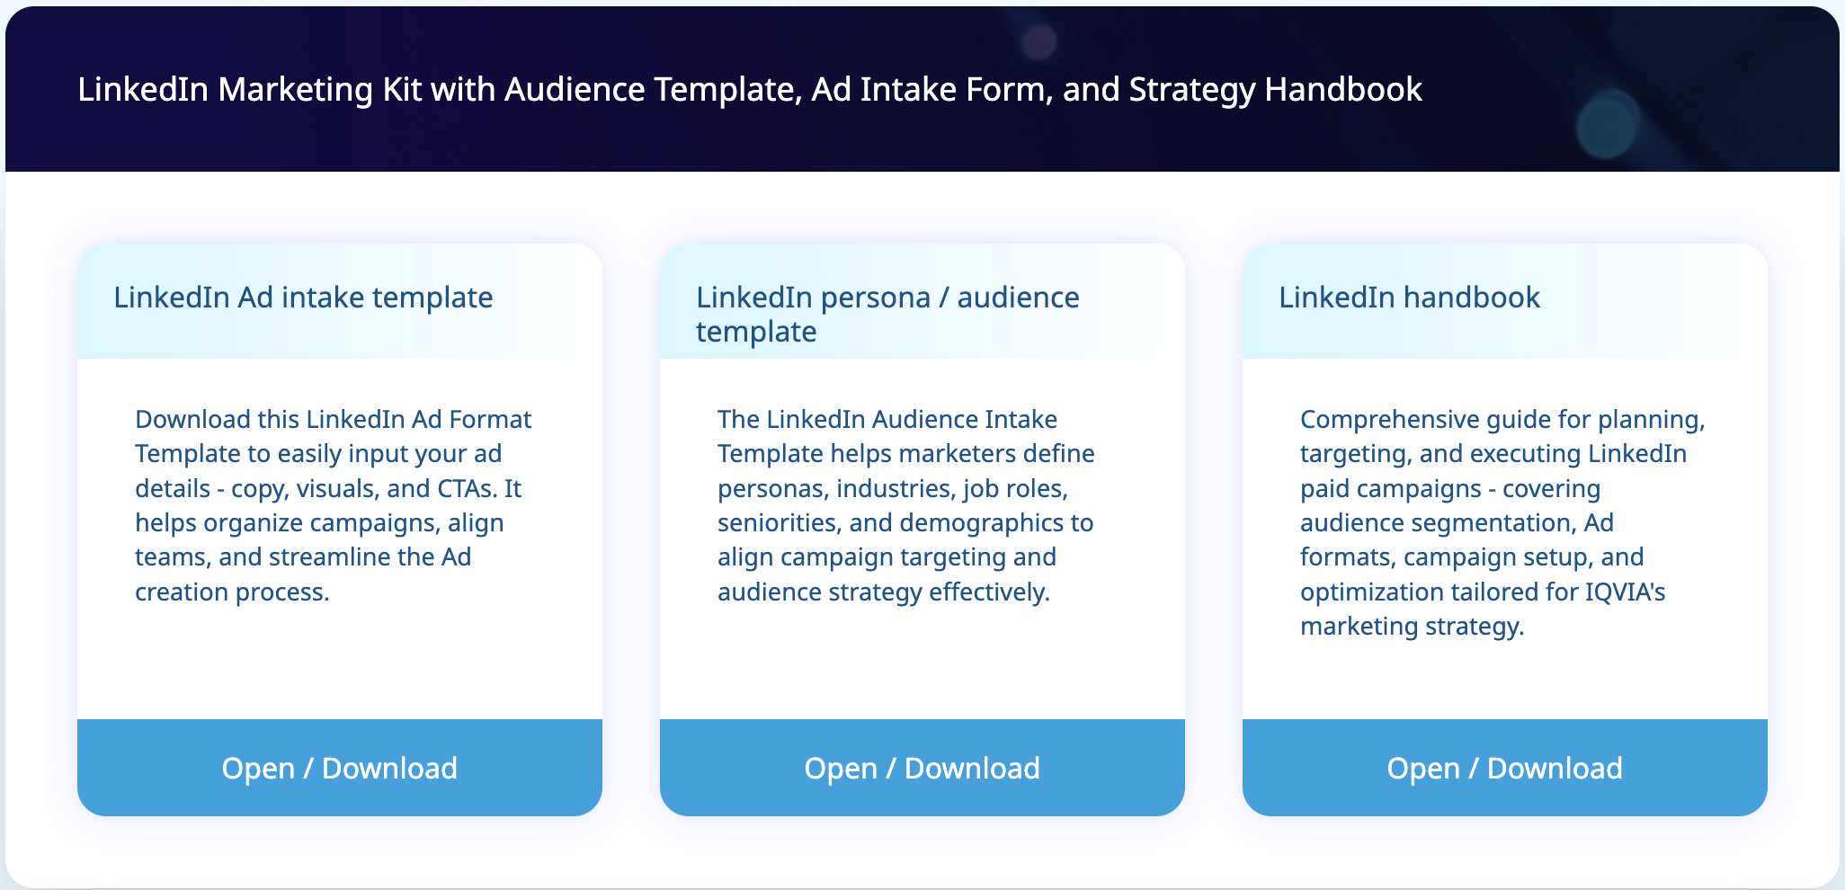
LinkedIn paid campaign resources

Slide 6
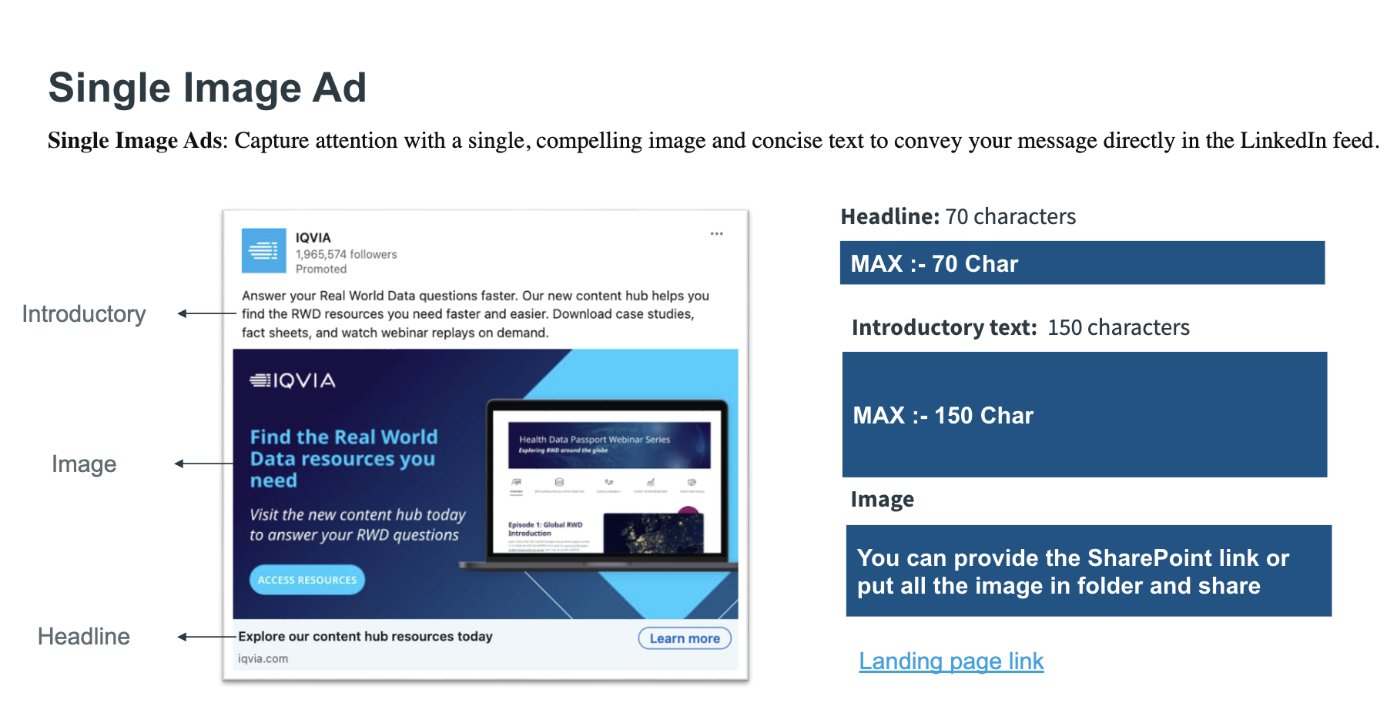
LinkedIn Ad Copy Intake Template
LinkedIn Ad Format Template
The LinkedIn Ad Intake Template is a structured tool designed to simplify the ad creation process. It allows teams to input essential ad components such as copy, visuals, and calls-to-action, helping organize campaign details and streamline execution. The template covers most of LinkedIn’s supported ad formats, ensuring consistency and making it easier to select the right format based on campaign goals.

Slide 7
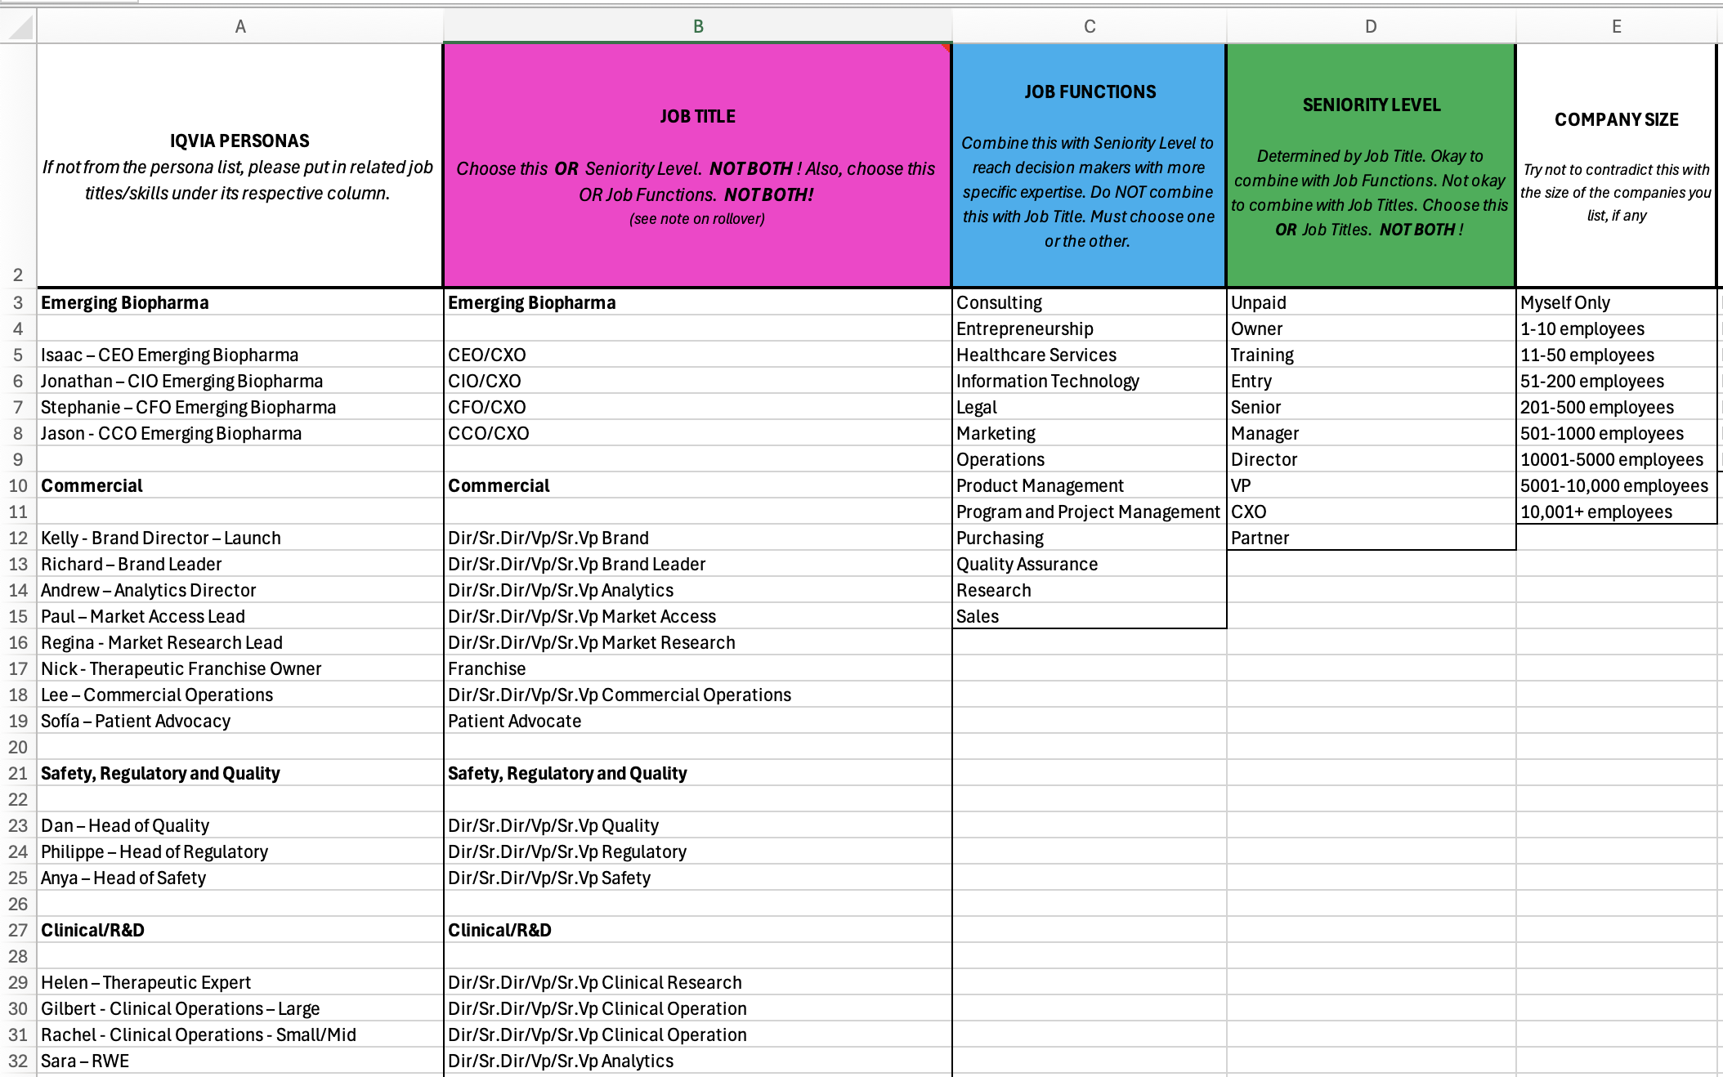
LinkedIn persona / audience template​
Audience Template
The LinkedIn Audience Intake Template helps marketers define and organize key audience attributes such as personas, industries, job roles, seniorities, and demographics. It supports effective campaign targeting by aligning audience strategy across teams and ensuring consistency throughout the planning process. The template is built based on the IQVIA persona framework, making it easier to tailor campaigns to relevant audience segments and marketing objectives.

Slide 8
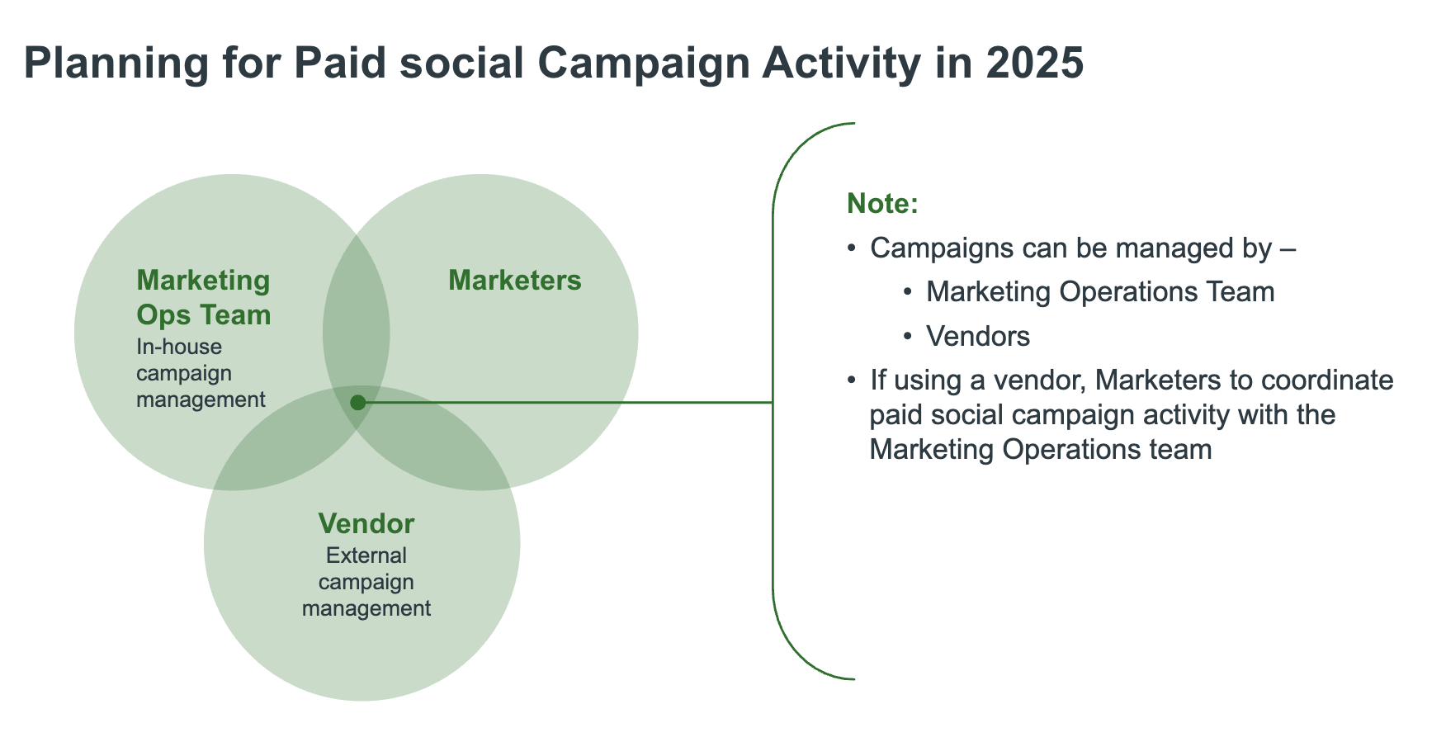
LinkedIn Handbook​
LinkedIn Handbook
This comprehensive guide is designed to support the planning, targeting, and execution of LinkedIn paid campaigns. It covers key areas including audience segmentation, ad formats, campaign setup, and optimization strategies. The content is tailored to align with IQVIA’s marketing approach, helping teams build effective and consistent campaigns across LinkedIn.

Slide 9
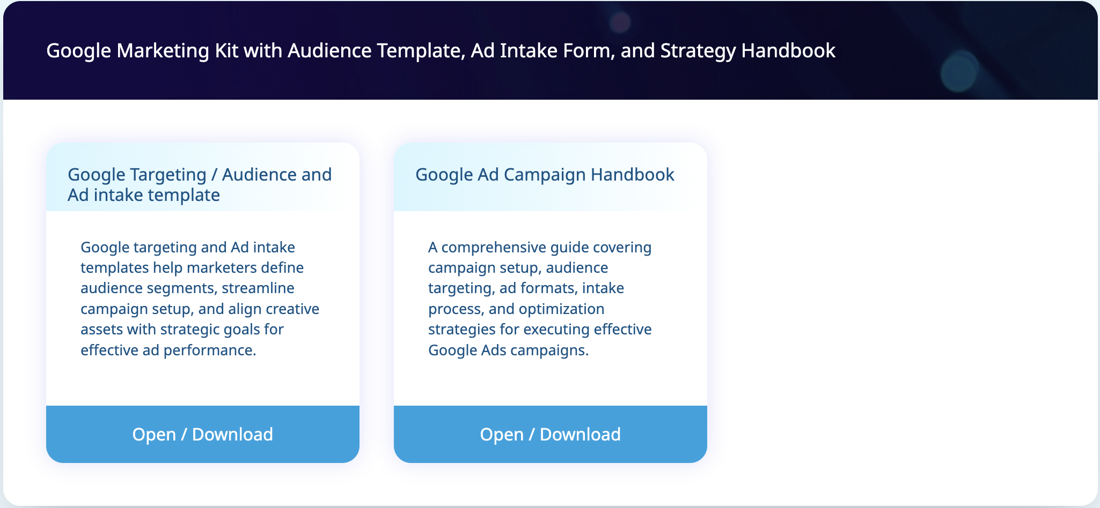
Google Ads resources

Slide 10
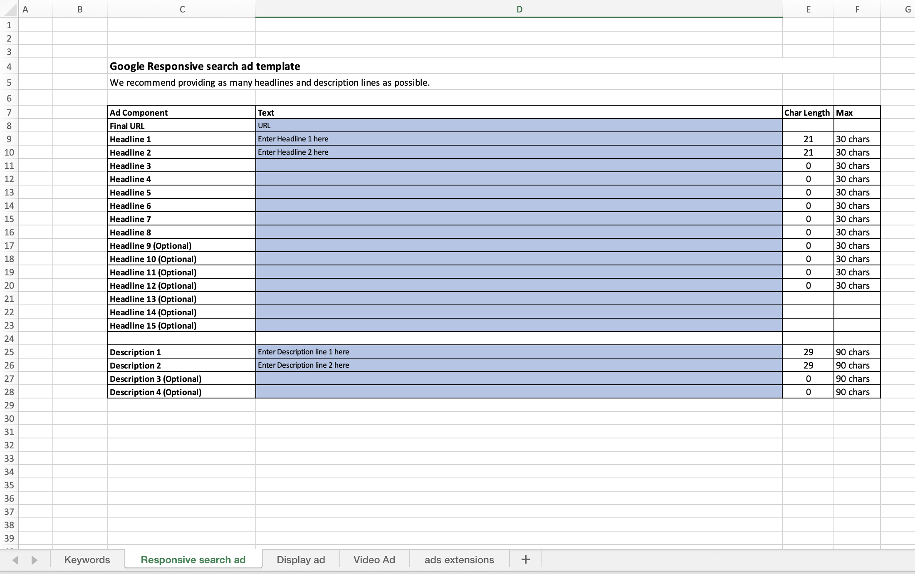
Google Targeting / Audience and Ad intake template
Google Targeting and Ad intake template
The Google Targeting and Ad Intake Templates help marketers define audience segments, streamline campaign setup, and align creative assets with strategic goals. These templates are designed to support effective ad performance by organizing key targeting parameters and ensuring consistency across teams and campaigns.

Slide 11
Google Ad Campaign Handbook​
Google Handbook
This comprehensive guide supports the execution of effective Google Ads campaigns by covering all essential components—campaign setup, audience targeting, ad formats, intake process, and optimization strategies. It is designed to help marketers plan and manage campaigns with clarity and consistency, aligning each step with strategic goals for better performance.

Slide 12
Demo on how to pull website metrics using Marketing Performance Hub (MPH)
Sandeep Kamboj
Marketing Operations Open Office Hours October 8, 2025

Slide 13
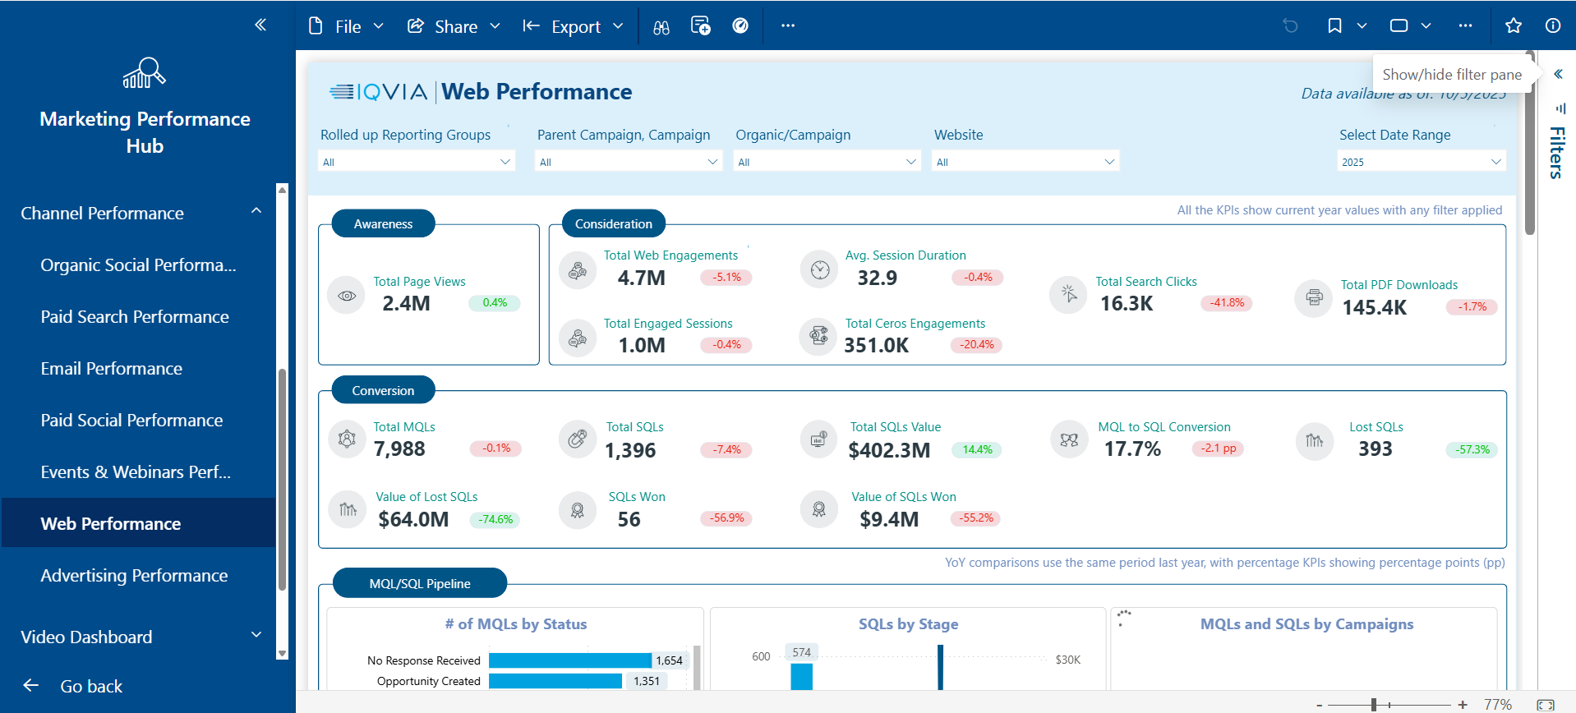
“Filters are an effective way to narrow down and extract the specific data you need.”
“The additional filter on the right panel can be useful for extracting data based on a specific link, marketer, or even the marketer’s country.”
“The Website Performance dashboard is located under the Channel Performance section.”

Slide 14
Thank You

